Slide 1
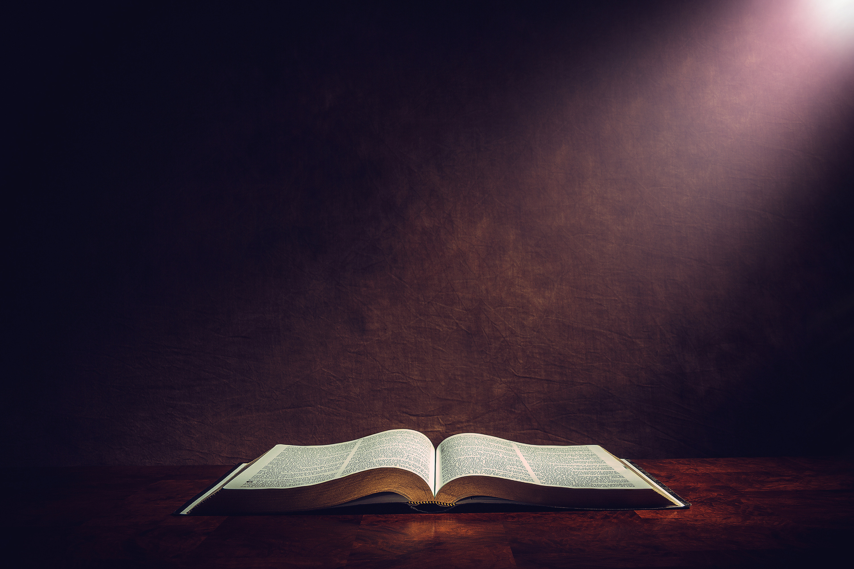

A STORY OF REDEEMING LOVE
INTERPRETING THE BIBLE

Slide 2
Do you have a consistent rhythm of reading the Bible?

Slide 3
Warning: The Bible has been a force for good in the world, it has also been misused in harmful ways.

Slide 4
Psalm 23 (NIV)
The Lord is my shepherd, I lack nothing.
He makes me lie down in green pastures,
he leads me beside quiet waters, he refreshes my soul. He guides me along the right paths for his name’s sake.

Slide 5
Psalm 23 (NIV)
Even though I walk through the darkest valley, I will fear no evil, for you are with me;
your rod and your staff, they comfort me. You prepare a table before me in the presence of my enemies.

Slide 6
Psalm 23 (NIV)
You anoint my head with oil; my cup overflows. Surely your goodness and love will follow me all the days of my life,
and I will dwell in the house of the Lord
forever.

Slide 7




What is the Bible
Book
Story
Revelation

Slide 8
What is the Bible
Made up of 66 Books
Old Testament: 39 Books
New Testament: 27 Books
All loose-ends are bought together by Jesus

Slide 9
What is the Bible
Old Testament
Predominately Hebrew: A Poetic Language - Written right to left

Slide 10
What is the Bible
New Testament
Predominately Greek: Not classical Greek (for the elite) but Koine Greek (Street language)

Slide 11
What is the Bible
Aramaic is found in the Old Testament
Daniel: Chapters 2:4 through 7:28 of Daniel are written in Biblical Aramaic.
Ezra: Sections of Ezra, specifically 4:8–6:18 and 7:12–26, are in Aramaic. These portions often concern official letters and correspondence related to the rebuilding of the Temple.
Genesis and Jeremiah: Two short, isolated phrases, "Yegar Sahadutha" (Genesis 31:47) and "Lama luba" (Jeremiah 10:11), are also in Aramaic.

Slide 12
What is the Bible
Aramaic is found in the New Testament
Aramaic words and phrases: While most of the New Testament was written in Greek, several words and phrases are clearly Aramaic, reflecting the Aramaic spoken by Jesus and his followers. Examples include "Talitha koum" (Mark 5:41), meaning "Little girl, get up!", and "Ephphatha" (Mark 7:34), meaning "Be opened!".
The phrase "Maranatha" (1 Corinthians 16:22) is another example of a Aramaic word in the New Testament, meaning "Our Lord, come!".

Slide 13
What is the Bible
It is made up of around 40 authors
Written over a 1,500 year period

Slide 14
Styles of Bible literature
  Stories
  Poems
  Laws
  Prophecies
  Biographies
  Letters to Christians
  Visions

Slide 15
Is the Bible accurate?

Slide 16
Top three Tips
CONTEXT
CONTEXT
CONTEXT

Slide 17
WHAT
| NOW WHAT

Slide 18
2 Timothy 3:16-17 (NIV)
All Scripture is God-breathed and is useful for teaching, rebuking, correcting and training in righteousness, so that the servant of God may be thoroughly equipped for every good work.

Slide 19
How do you feel about the Bible being God breathed?

